Slide 1
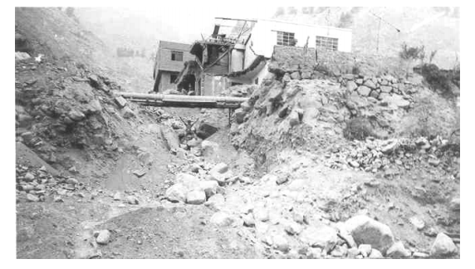
APEC 2013, FEB. TOKIO
"PREPAREDNESS TO FLOOD AND NATURAL DISASTER FROM THE EDUCATION"
Perú – Mónica Miyagui

Slide 2
The total annual rainfall is 10 mm in the coastal area and about 1,000 mm in the mountainous area. The annual amount of precipitation in Lima, Matucana and Milloc, is 10mm, 270 mm and 660 mm respectively.
Place | Annual rainfall (mm)
Lima | 10
Chosica | 24
San Mateo | 38
Milloc | 660
If flood occurs in Lima from rainfall in Chosica, what might be the height?

Slide 3
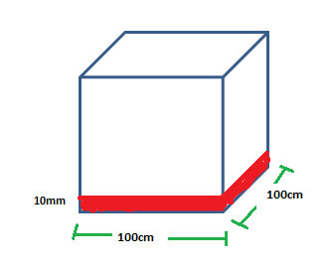
Task 1
What is the volume of water equivalent of 10mm?
Filled with water to a height of 10mm, a container of 1m long and 1 m wide. Calculate the volume V = AXH,
V = 100cmx100cmx0, 1cm = 1000cm³
1000cm³ is equivalent to 1000ml, then converted to 1 l

Slide 4
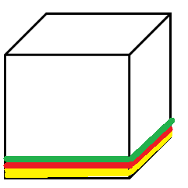
Task 2
Filled with water to a height from 10mm, to 24 mm , to increased 2mm each and calculate the volume
V = AXH, V=100cmx100cmx...cm = …………. cm³

Slide 5
w(cm) | l(cm) | H (cm) | Volume (cm3) | Litres
100 | 100 | 0.1 | 1000 | 1
100 | 100 | 0.12 | 1200 | 1,2
100 | 100 | 0.14 | 1400 | 1,4
100 | 100 | 0.16 | 1600 | 1,6
100 | 100 | 0.18 | 1800 | 1,8
100 | 100 | 0.2 | 2000 | 2,0
100 | 100 | 0.22 | 2200 | 2,2
100 | 100 | 0.24 | 2400 | 2,4

Slide 6
Task 3
The meaning of 1mm annual rainfall.
Fill 1 l of water into receptacles with different dimensions . Compare the level ofthe same volume of liquids in these different containers.
Model: Observe that the water height is lower as the base increases.

Slide 7
Task 4
If the length of the receptable increases by 5 cm each, which is the change of the level of water? Which is the change that causes the height to decrease each time?
Volume | Width (cm) | Length (cm) | High (mm)
1000 | 100 | 105 | 9,5
1000 | 100 | 110 | 9,1
1000 | 100 | 115 | 8,7
1000 | 100 | 120 | 8,3
1000 | 100 | 125 | 8,0
1000 | 100 | 130 | 7,7
1000 | 100 | 135 | 7,4
1000 | 100 | 141 | 7,1
1000 | 100 | 145 | 6,8

Slide 8
Thank you very much

